Slide 1




Sahil
Jena
Ecommerce
Sales
Intelligence

Slide 2

Overview
Project Objective & Dataset Overview
Total Revenue Analysis
Popular Product Categories
Average Spend & Payment Type
Sellers Activity Over Time
Top Selling Products & Trends
Impact of Rating & Overviews
Repeat vs One Time Customer
Revenue & Order Trends
Rating and Review Analysis
Top Product Categories
Recommendations
01
02
03
04
05
06
07
08
09
10
11
12

Slide 3


Project Objective &
Dataset Overview
Goal: Derive business insights from e-commerce data using SQL & Power BI.
Duration: Sept 2016 – Oct 2018
Data: 7 Tables – Customers, Orders, Payments, Products, Reviews, Sellers, Order Items

Slide 4



SQL

Slide 5


Total Revenue Analysis
How much total money has the platform made so far, and how has it changed over time?
Monthly Revenue Insights (Sep 2016 – Oct 2018)
Total Revenue: ₹16M+
Launch Phase: Sep–Dec 2016 (very low revenue)
Growth Phase: Jan 2017 – Aug 2018 (stable growth, ~₹1M/month )
Peak Revenue: Apr 2018 (₹1.16M)
Sharp Drop: Sep–Oct 2018 (~99% fall) – likely data cutoff or shutdown
Seasonal Spike: Nov 2017 & early 2018 show high sales (likely festive impact)
Business Insight :
Seasonal spikes (festive), declining trend in late 2018

Slide 6


Popular Product Categories
Most Ordered
Bed, Table & Bath (10,953 orders) – daily essentials
Which product categories are the most popular, and how do their sales numbers compare?
Top Revenue
Beauty & Health (₹1.23M) – high-value products
Business Insight :
Seasonal spikes (festive), declining trend in late 2018
Watches & Gifts
Fewer orders (5,859), but high revenue (₹1.16M) – premium items.

Slide 7






Average Spend & Payment Type
What is the average amount spent per order, and how does it vary by category or payment method?
01
02
03
04
Credit cards generally dominate average spend but vouchers outperform credit cards in specific categories (e.g., Music Instruments, PCS, Women’s Fashion).
Overall average order amount: 154.1
Debit cards sometimes lead in spend for niche categories like Air Conditioning and Fixed Telephony.
Boleto generally ranks third or fourth but still shows competitive spends in categories like Agriculture and PCS.

Slide 8

Seller Activity Over Time
How many active sellers are there, and how does this number trend?
2017: Rapid seller onboarding consistent month-over-month growth.
Total Active Sellers : 3095
Strong Growth : From 219 in Jan 2017 to 1261 in Aug 2018
2018: Growth continued but started to slow down after June.
Peak Month: Aug 2018 with 1261 active sellers
2016: Minimal activity — likely platform launch or incomplete data .

Slide 9


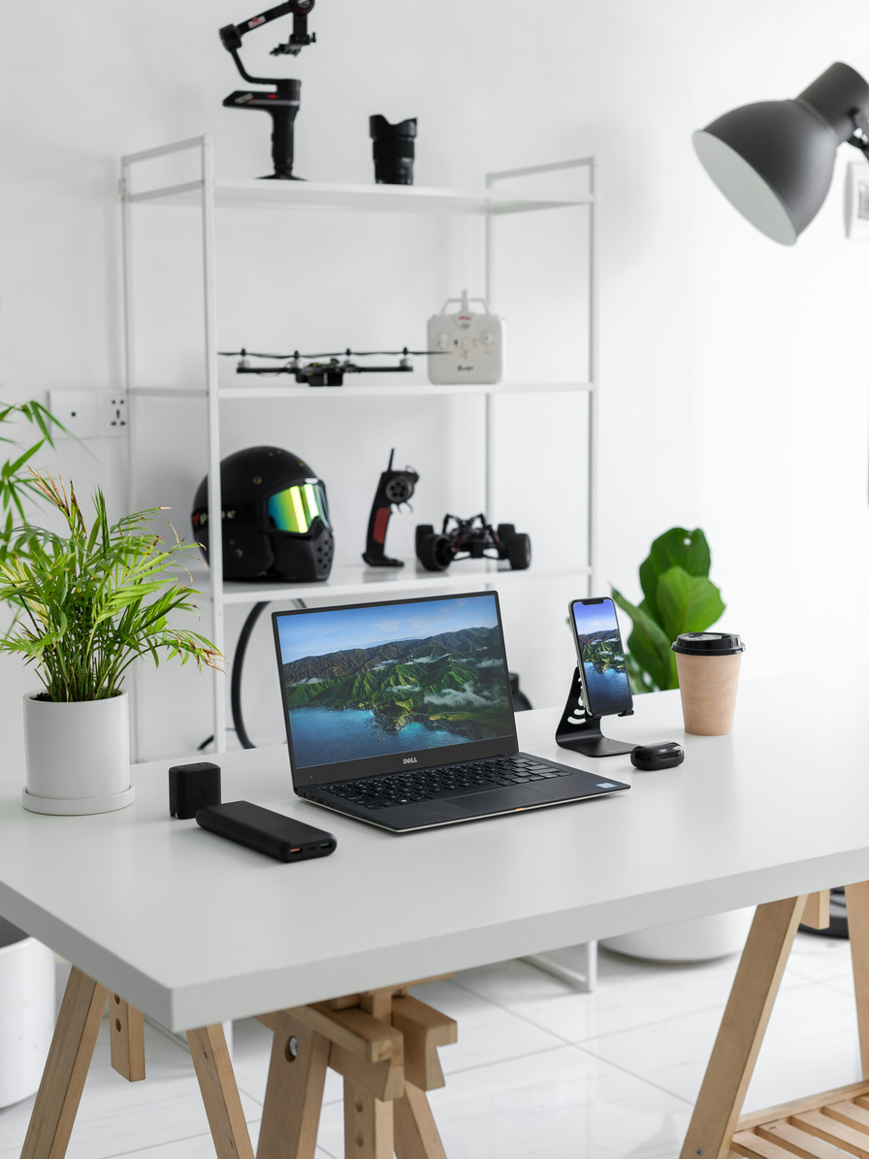


Top Selling Products & Trends
Bed, Table & Bath
Beauty & Health
Sports & Leisure, Computers & Accessories
Watches & Gifts
Most frequently purchased category — essential goods with broad appeal.
Fewer units than Bed & Bath but contributes significantly to revenue.
High movement; often driven by seasonal demand or trends.
Not top by volume, but strong revenue suggests premium pricing.

Slide 10



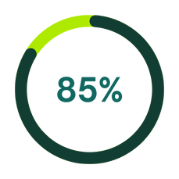
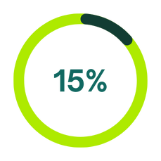
Impact of Ratings & Reviews
Do customer reviews and ratings impact sales?
5-star reviews drive the most sales
Highest orders (63.5k) and revenue (₹7.7M).
1-2 Stars reviews Low sales
Low-rated (1–2 star) orders are fewer and earn much less.

Slide 11

Power BI

Slide 12
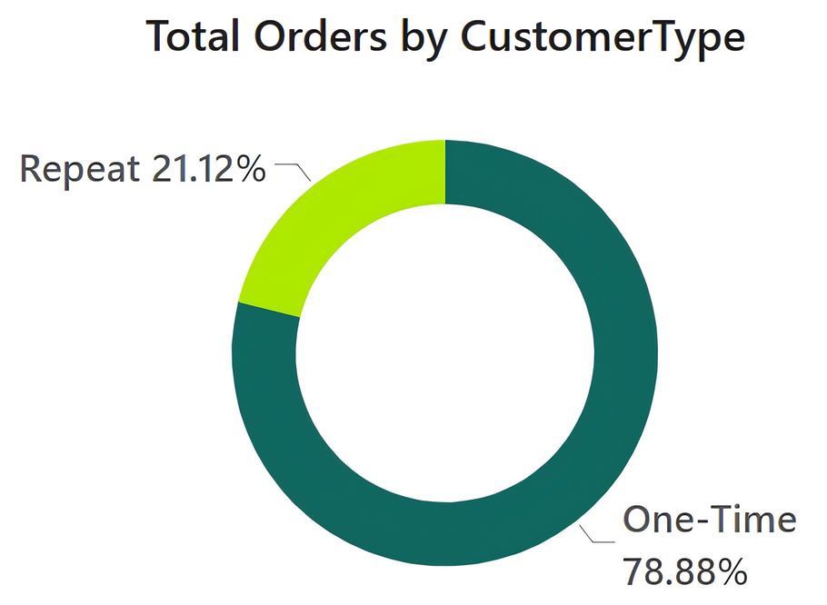
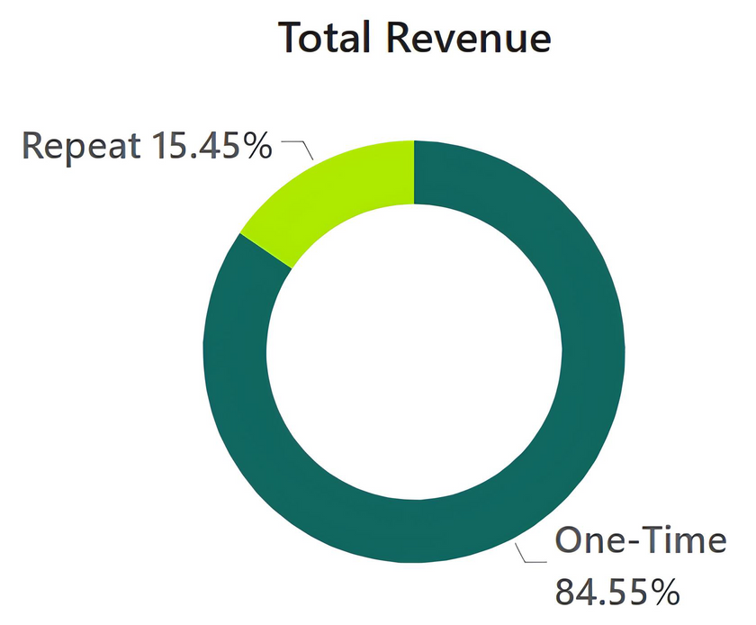
Repeat vs. One-Time Customers
Understand contribution of loyal customers
One-Time Customers: 84.55% of revenue, 88.86K orders
Repeat Customers: 15.45% of revenue, 23.79K orders
Business Insight :
Large dependency on new customers → retention campaigns needed

Slide 13

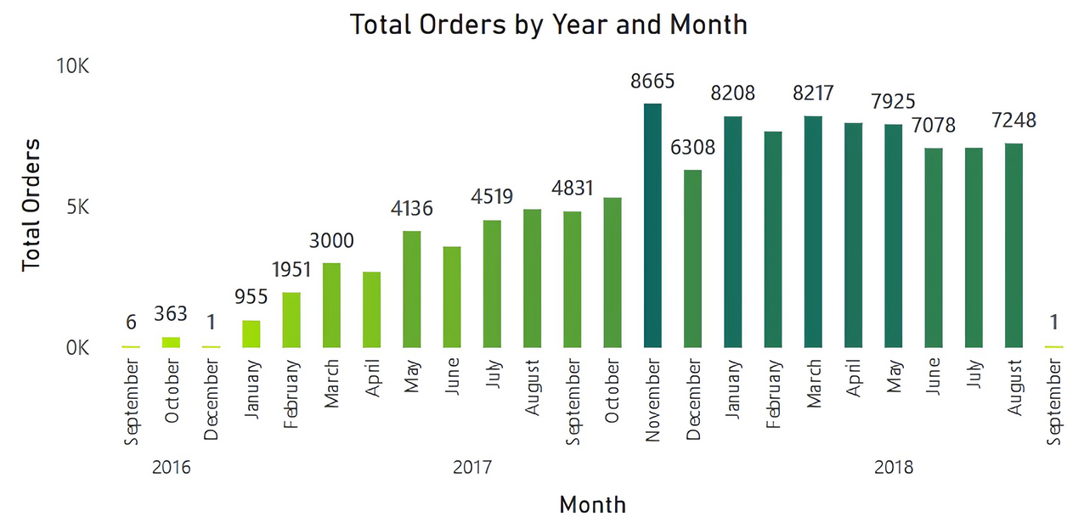
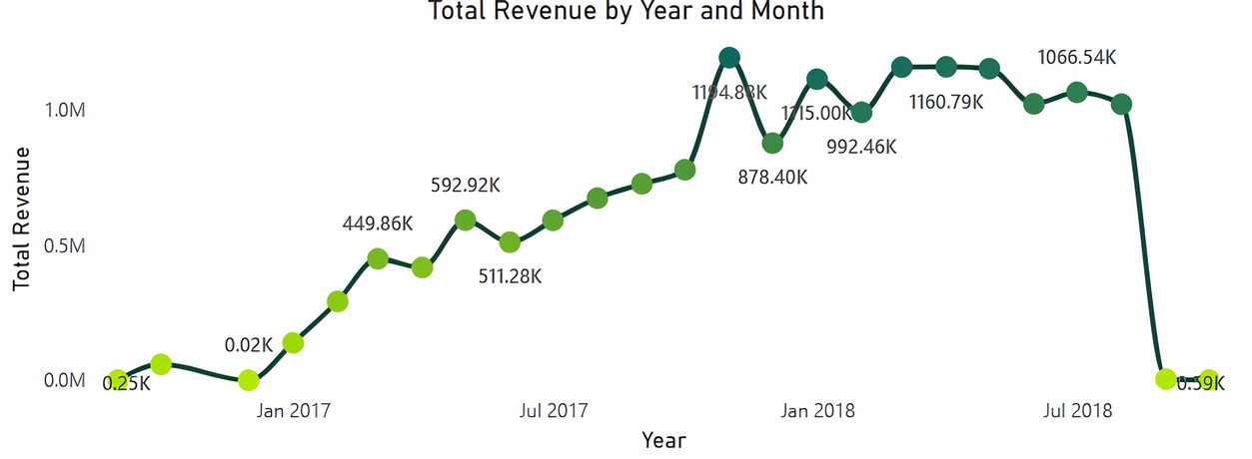
Revenue & Order Trends
Monitor performance over time
Growth trend until mid-2018
High sales in festive months
Drop post-Sept 2018

Slide 14
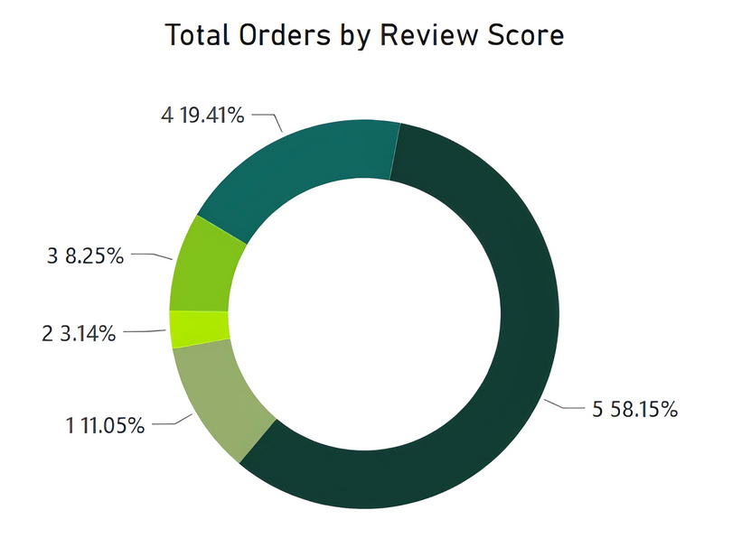
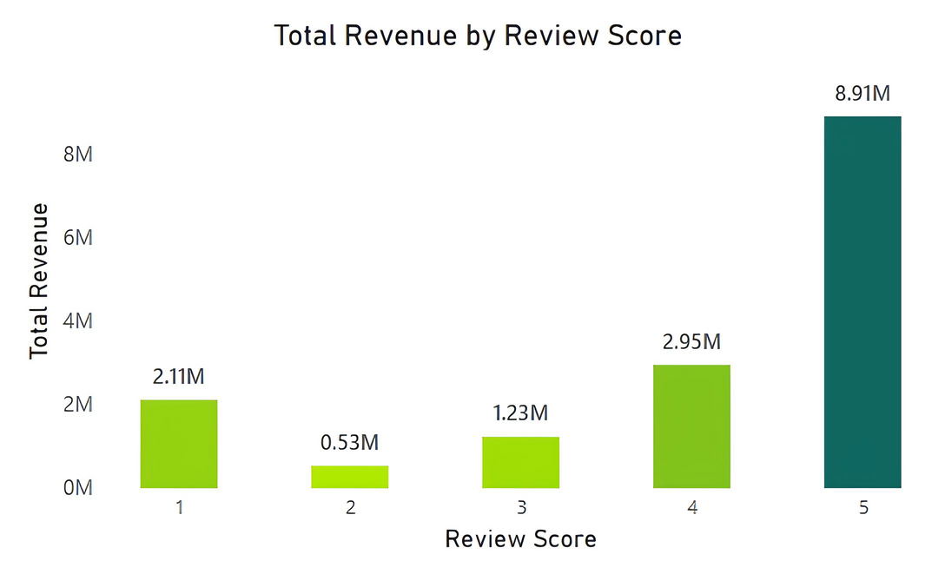
Ratings & Review Influence
Examine how reviews affect sales volume
Avg Rating: 4.09
High-rated products earn more and sell more

Slide 15
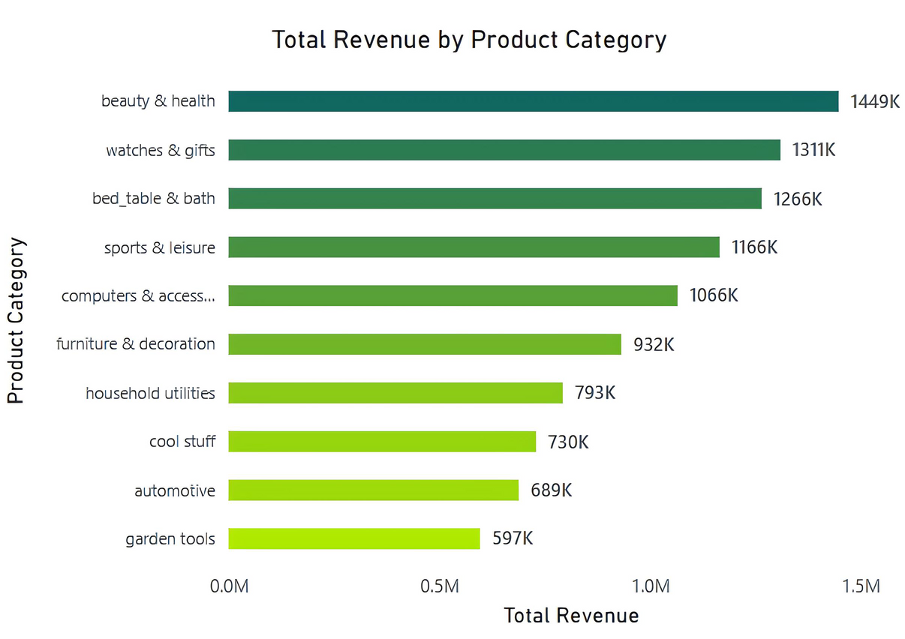
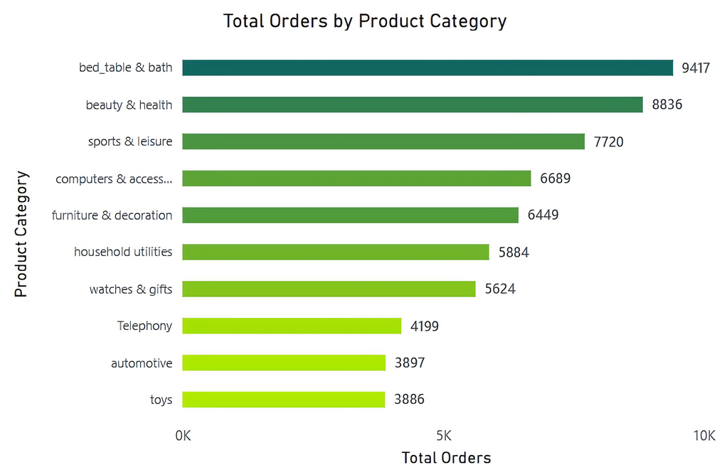
Top Product Categories
Identify major sales contributors
Beauty & Health, Bed & Bath, Sports & Leisure lead
Trend chart shows seasonal demand

Slide 16
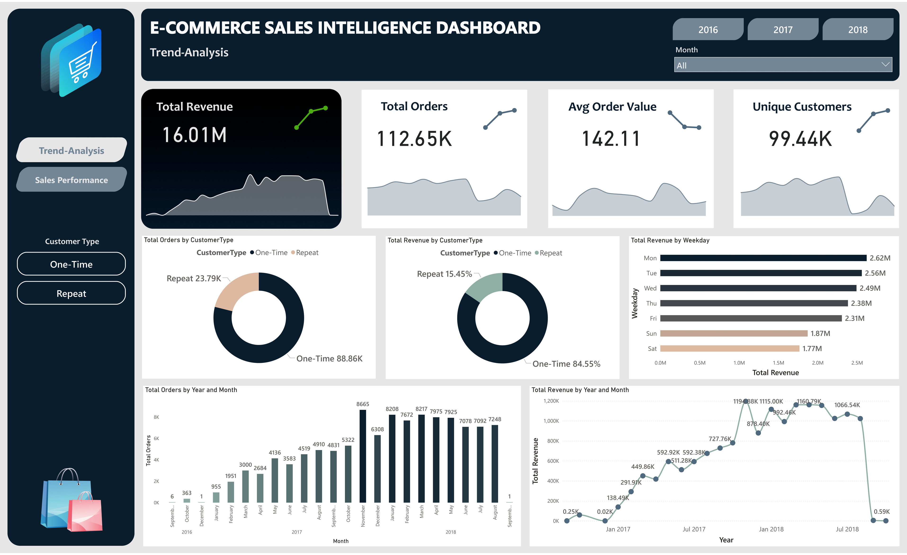

Slide 17
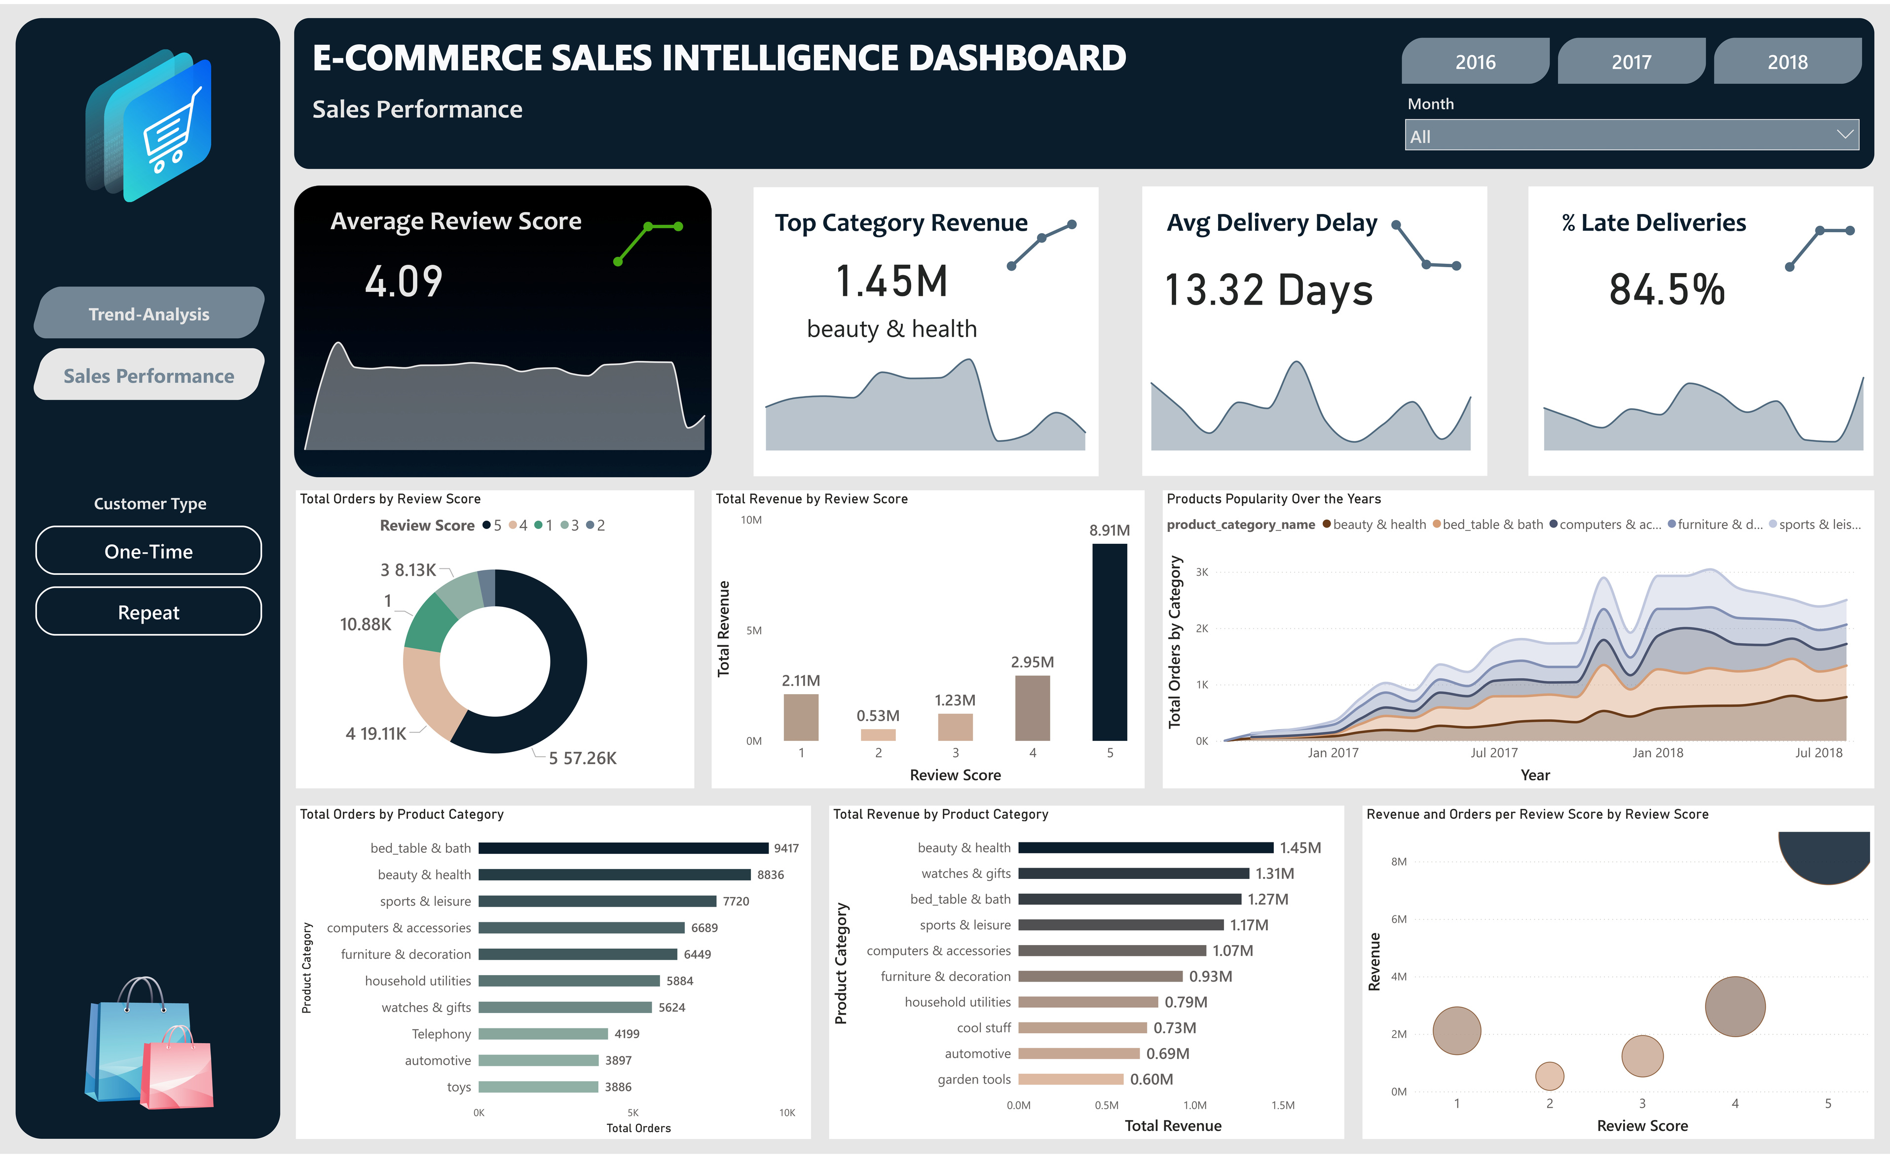

Slide 18

THANK TOU
For watching this presentation
Sahil Jena

